Slide 1


Student Activities Locator
Notes:
Wes talking

Slide 2
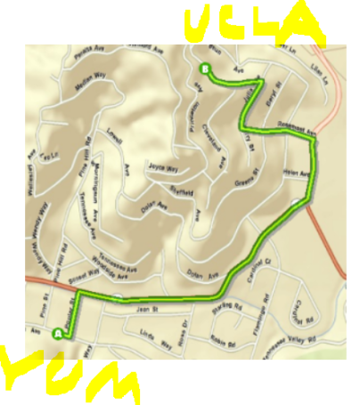
Created by:
George Owen
Grant Linford
Peter Flanders
Wesley Motlow
Seamus Sehres
Notes:
Wes talking

Slide 3
The problem:
There are so many places to eat and things to do in LA that it’s hard to find stuff that’s actually worth what little money and free time students have
Notes:
Wes talking

Slide 4
The solution:
A MAP!
Or in this case a lot of maps
Notes:
Wes talking

Slide 5
What makes these maps special?
They are made by students, for students
Notes:
Wes talking

Slide 6
Our Approach
Python scripting to generate a mapbook of routes
Notes:
Wes talking (emphasize ROUTES )

Slide 7
Our Goal
Target output: A toolbox that creates a routing mapbook based on a dataset and user location
Notes:
Wes talking (emphasize ROUTES )

Slide 8
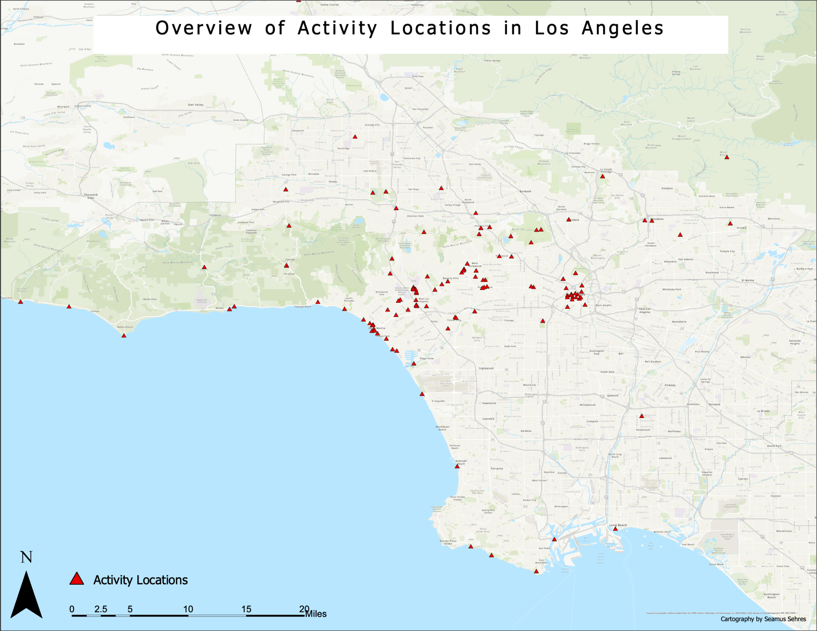
Notes:
Seamus – Here is an overview map of all the locations we are trying to decipher the fastest routes to by walking, driving, or biking to get from an area in westwood where a student would be to an activity in or around Los Angeles.

Slide 9
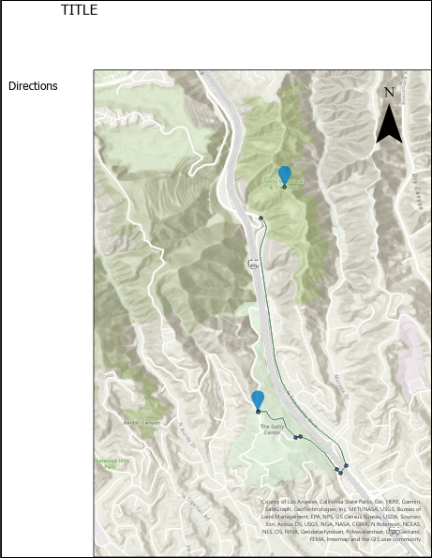
APRX Layout
Example of page in the mapbook
Notes:
This is a rough draft of our aprx layout for the mapbook. Under directions it will list the steps you need to take to get from point A to Point B

Slide 10
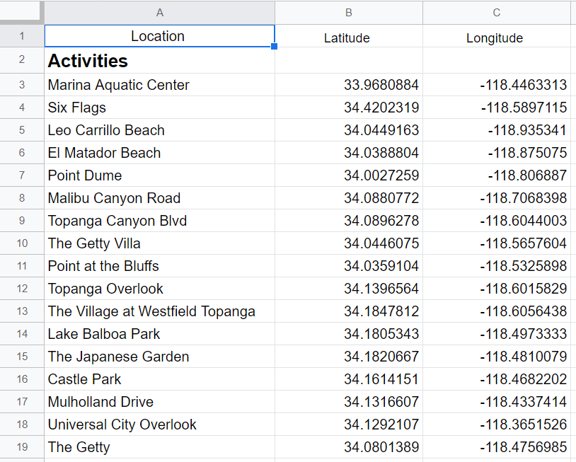
The Locations
Homegrown Dataset
Collected by hand by our group members.
Notes:
Seamus - We made this data set ourselves by narrowing down some of our favorite places to visit such as restaurants, bars, beaches and amusement parks, we then found the latitude and longitude of each location and compiled those points into a spreadsheet to work with and input into a python script

Slide 11
Code Skeleton
Loop through all of our data points:
Generate a route from the start location to that data point and load it into arcgis pro
Format a layout using the route and driving directions, and export it to the mapbook
Notes:
Seamus- at a high level this is what the project should do, loop through all of our set data points, generate a route from the start location to that data point and then load it into arcgis pro, then format a layout using the route and driving direction to finally be exported into a mapbook

Slide 12
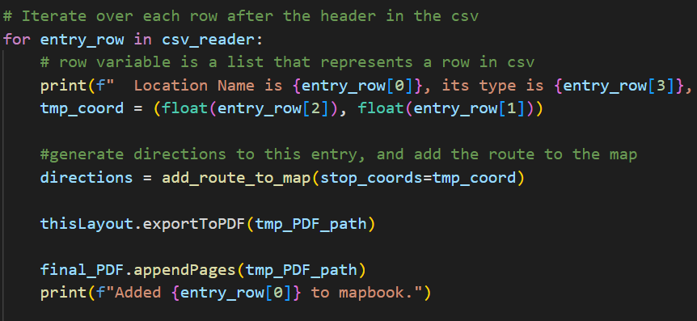
Mapbook Creation
Notes:
Peter

Slide 13
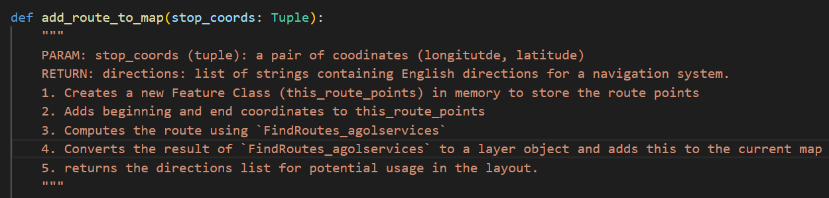
Add Routes To Map Function
Notes:
Peter

Slide 14
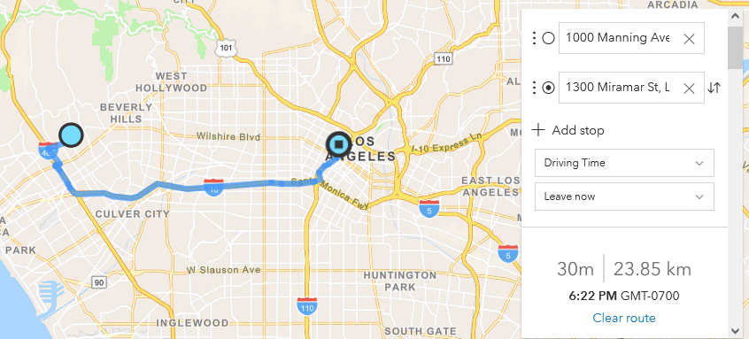
arcpy.agolservices.FindRoutes()
(image taken from arcgis developer routing service tutorial)
Notes:
GEORGE

Slide 15
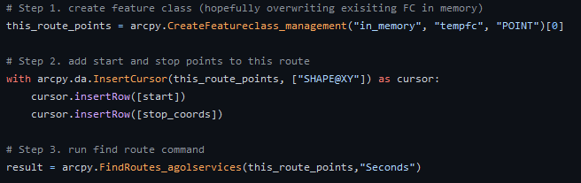
Calling arcpy.agolservices.FindRoutes()
https://pro.arcgis.com/en/pro-app/2.8/tool-reference/ready-to-use/itemdesc-findroutes.htm
Finds shortest path that visits all points of input featurelayer - knows traffic
Consumes credits
Our ‘start’ is bruin bear, ‘stop’ is ‘stop_coords’
Notes:
GEORGE

Slide 16
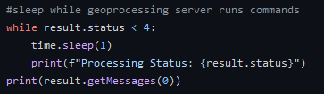
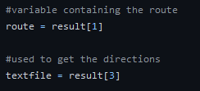
FindRoutes() Output
https://pro.arcgis.com/en/pro-app/2.8/tool-reference/ready-to-use/output-findroutes.htm
Asynchronous function; runs on server and returns into Result promise object
Doesn’t wait automatically (or w/ ‘await’); have to use time.sleep()
Output is generic ArcGIS Result object template
There’s a TON of data; 10 different outputs
We’re using “output_routes” (1) and “output_direction_lines” (3)
Notes:
GEORGE

Slide 17
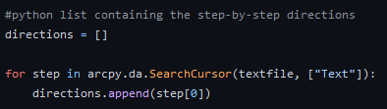
Using the Output Data
Add feature class to aprx to display on layout
Store directions in Python list, return from function
Need to remove / overwrite previous layers before moving to the next data point
Parameterization into a function allows modular looping
Notes:
GEORGE

Slide 18
Issues
Using findroutes_agolservices has not been perfect
What Data Lies within the Result Object?
RecordSets, FeatureSets, Feature Classes, vs. Feature Layers
Adding our route result to our ArcGIS Pro project proved very difficult!
Currently, the data is not showing as a proper layer. (UPDATE: fixed this morning)
Notes:
Peter

Slide 19
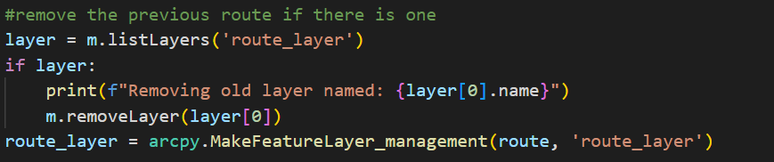
Handling project layers
Adding the `route` object vs. `route_layer` object
Notes:
Peter

Slide 20
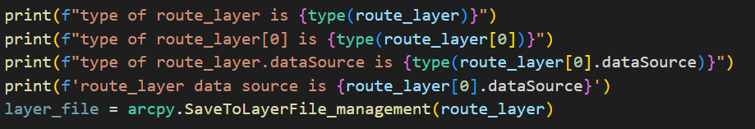
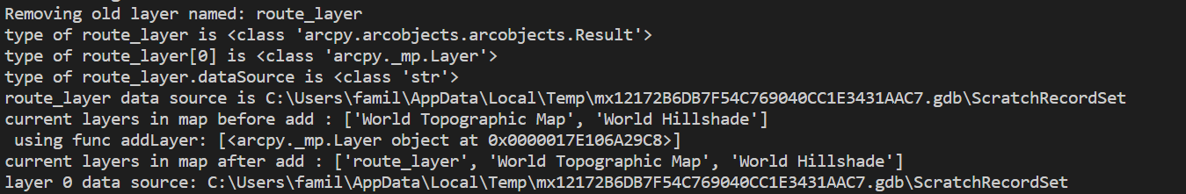
Lots of Debugging!
Notes:
peter

Slide 21
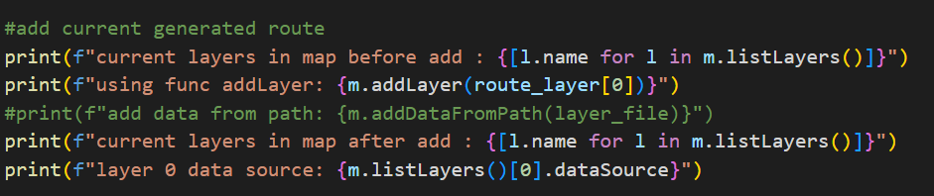
Even more Debugging!
Notes:
peter

Slide 22
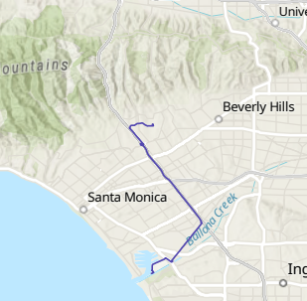
Current Output
This is one page of many
Fixed it this morning!
Still need to merge layer file and a stylized layout
Notes:
peter

Slide 23
Moving Forward
Finishing draft of .aprx layout with other map elements
Creating a toolbox for the route function
Choose how many maps you want to see
Notes:
Grant – we still need to insert the common cartographic map elements associated with a layout in the .aprx and fine tune the mapbook output
creating the toolbox Allows for a better user interface and mapping from the user’s starting location instead of solely from the bruin bear statue
We also want to giving the user space to define their range eventually so that it doesn’t print out over a hundred maps each time.

Slide 24
Directions
directions = ['turn left', 'go straight', 'destination on left']
Str.join → text = "\n".join(directions)
sample code of what we will be doing to concatenate the direction information from the route function in arcpy
Notes:
Grant – seamus and I are working with the mapbook production of the code. We are focusing mainly on the directions parameter. We are taking the routes that peter and george have coded and then using the directions parameter in a for loop we’re going to output to a text element for each respective layout in the mapbook .aprx file that wesley drafted. Once functional we will be able to print out a comprehensive list of directions depending on the mode of travel between the start destination and the location of the activity
The first line of code is an example of the directions output from the list that George populated and the second line shows how the separator between elements is the string providing the method ‘\n’ is the delimiter between the directions that creates a new line in the text element for the layout to make the display of the directions more clear

Slide 25
Example
For loop structure will be applied to appending direction by…
Notes:
Grant – using the mapbook coding techniques we learned from lab 7 we’re going to append the concatenated directions from the function to the .aprx layout in a for loop much like we did for the FID and Area information that we posted with each lake in North America from lab 7
We will also likely need to make use of a search cursor with a for loop to automate the map frame extent around each specified route

Slide 26
Conclusion
What we did
Found locations of destinations relevant to student interests
Learned a complicated, powerful geoprocessing tool
Developed a python script to create a map book of the destinations
Importantly:
We made this using our skills developed in this class

